Slide 1
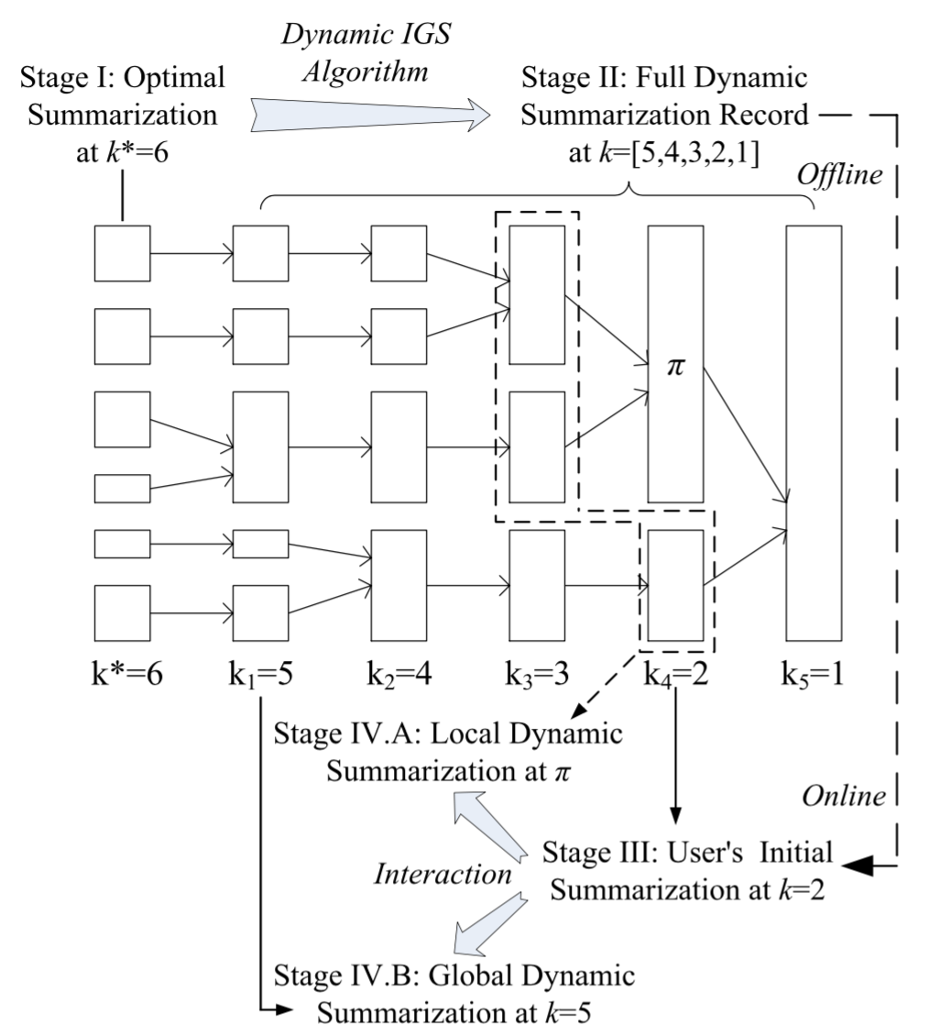





TOPIC: TOward Perfect InfluenCe Graph Summarization
Lei Shi, Sibai Sun, Yuan Xuan, Yue Su,
Hanghang Tong, Shuai Ma, Yang Chen

Slide 2
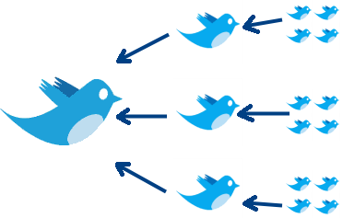


Influence Graph
Initial
Tweet
Source
Paper
Re-tweets
Citing papers
Re-tweeting Graph
Paper Citation Graph

Slide 3
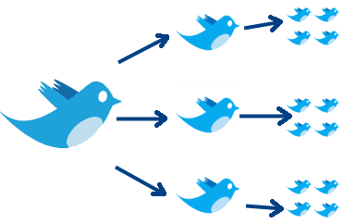
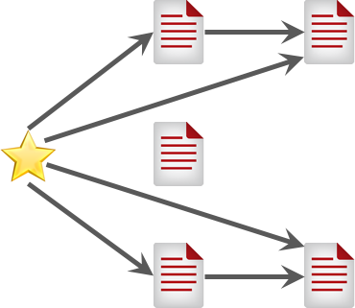
Influence Graph
Initial
Tweet
Source
Paper
Re-tweets
Citing papers
Social Influence Graph
Citation Influence Graph

Slide 4
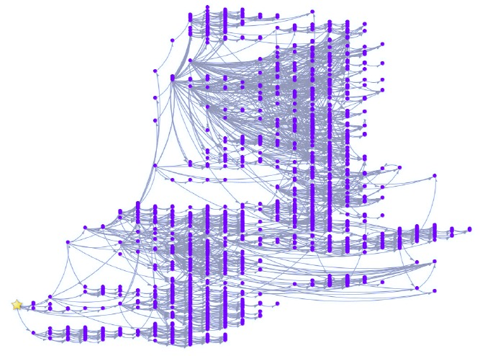
Challenges on Large Influence Graph
Scalable and high-quality layout algorithm
Overlapping nodes and crossing edges

Slide 5
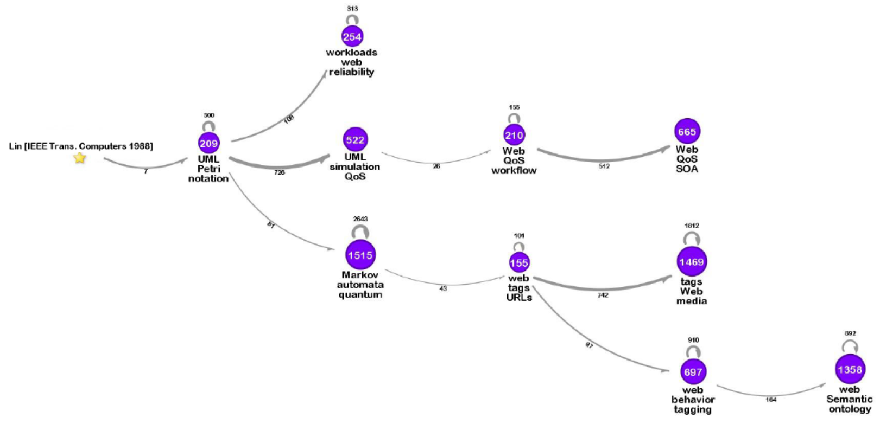
Influence Graph Summarization (IGS)
Flow
(below: flow rate)
Source node
(paper)
Clusters
(center: #size;
below: content summary)

Slide 6
Outline
Problem Definition
Theoretical Analysis and Optimal DP Algorithm
Scalable Heuristic Algorithms
Dynamic IGS Problem and the Stability Definition
Dynamic IGS Solution and Algorithm
Evaluation

Slide 7
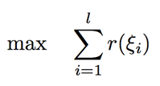
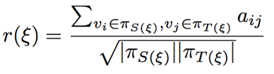
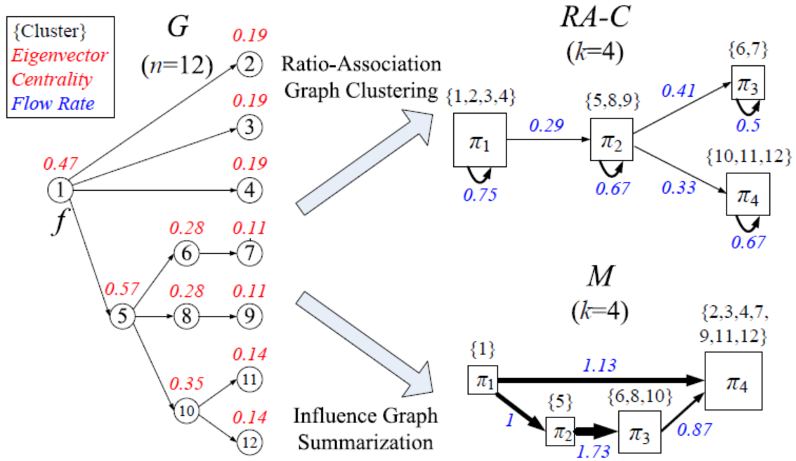
Problem Definition (TKDE 2015)
Objective: where
Comparison to the traditional graph clustering:
The objective is coherent (intra-cluster flows v.s. all flows)
Result is different: Dense clusters v.s. large flows

Slide 8
Limitation of Previous Work
Optimality of IGS objective is not guaranteed
High computational complexity: >O(n²)
Only consider the IGS problem given one fixed cluster number k
Dynamic IGS scenario with increasing/decreasing ‘k’s
These limitations motivate us to investigate new solutions to IGS problem.

Slide 9
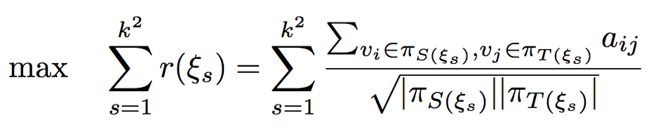
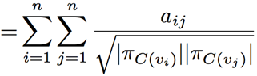
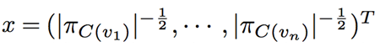
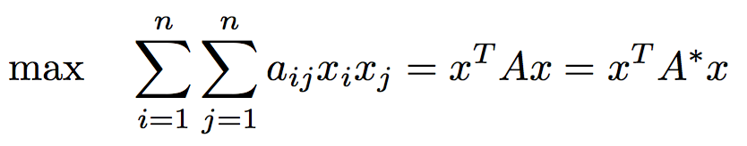
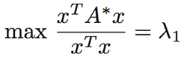
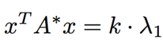
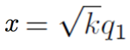
Theoretical Analysis on the IGS Objective
Key transformation on the IGS objective
Quadratic form (where )
By Min-max theorem
This optimality can not be achieved (constraints on x), we propose to optimize the largest component of x^{T} A*x in the eigen-decomposition

Slide 10
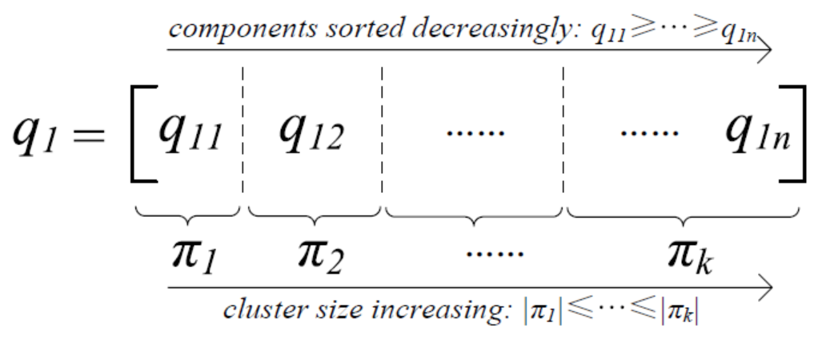
Equivalence to k-segmentation problem
k-segmentation on the largest eigenvector of A* (sorted decreasingly), cluster size should be non-decreasing

Slide 11
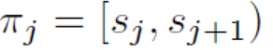
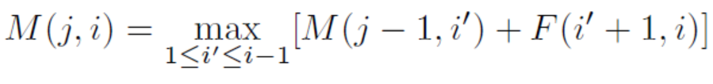
Dynamic Programming for k-segmentation
Define the gain of a cluster by
Write the objective of segmenting a sequence of length i into j clusters by M(j,i)
The optimization of objective can be computed iteratively from i=1, j=1 by
Computational complexity: O(n²k)

Slide 12
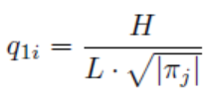
Scalable Approximate Algorithms
Iterative Stepwise Optimization (ISO)
By extended analysis we have an approximation of optimality
Computational complexity:
O(nlogn + n·I) (I: #iterations)

Slide 13
Scalable Approximate Algorithms
Greedy Curve Fitting (GCF)
Or we can let x fit q₁ directly after the length normalization
Complexity:
O(nlogn + n·I) (I: #iter)

Slide 14
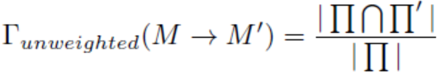
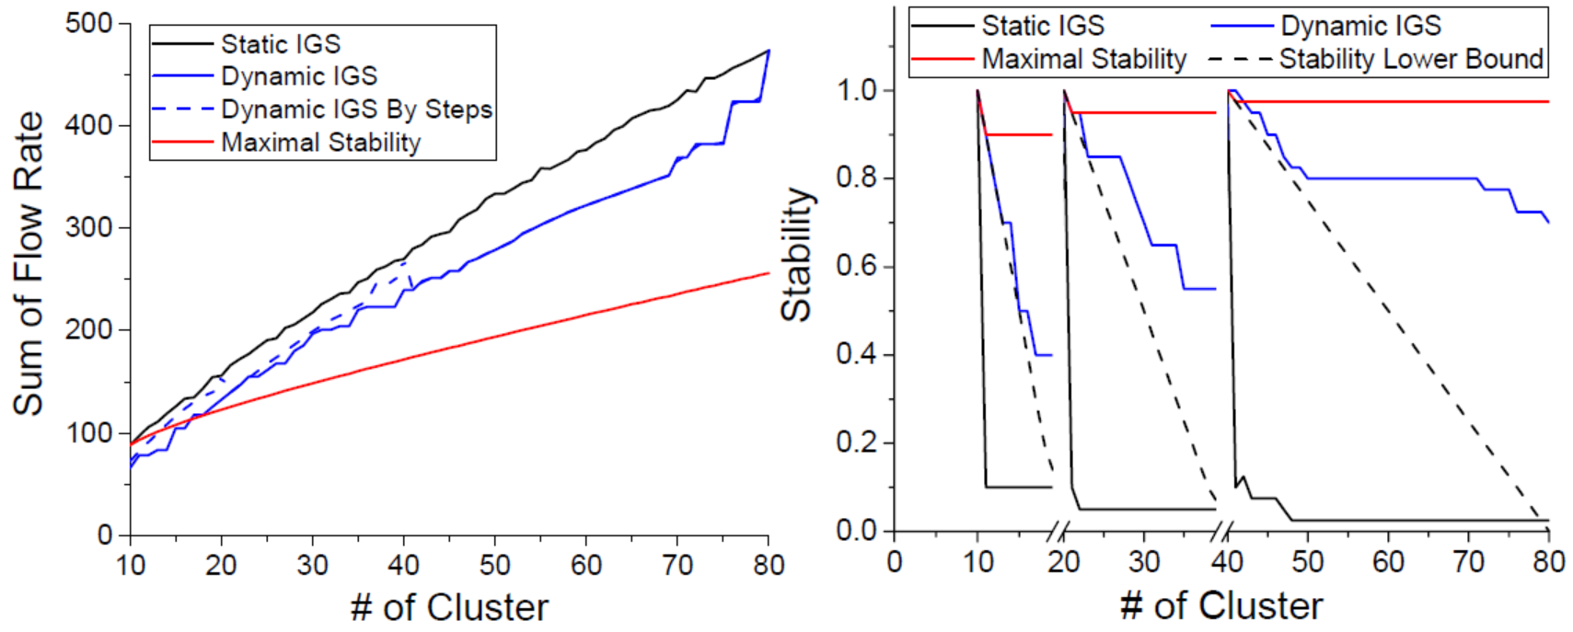
Dynamic IGS Problem and Its Stability
Dynamic means doing summarization according to a series of ‘k’s (e.g. 10, 20, 40, 80) rather than single k (e.g. 10).

Slide 15
Dynamic IGS Algorithm
The bottom-up approach
Start from the finest-granularity summarization and merge node clusters agglomeratively.
Enable the consistency between static and dynamic IGS algorithms
Algorithm – dynamic GCF
Work on the initial summarization graph M instead of the influence graph G
Theoretical consistency with the static GCF algorithm

Slide 16
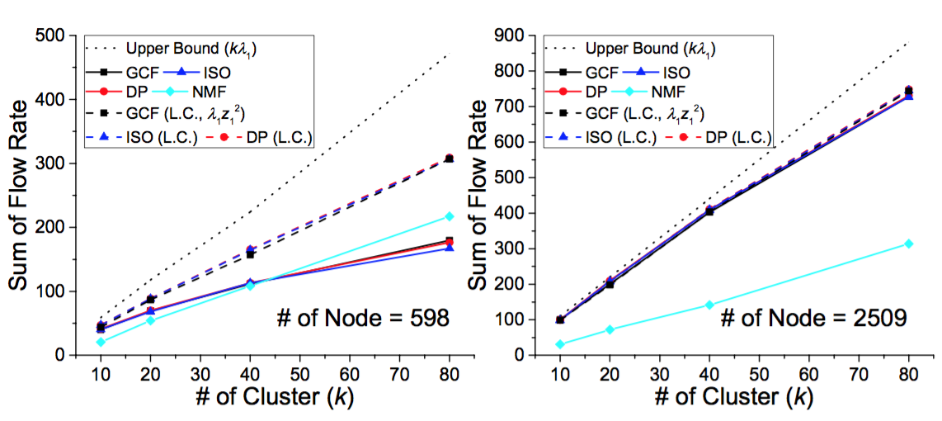
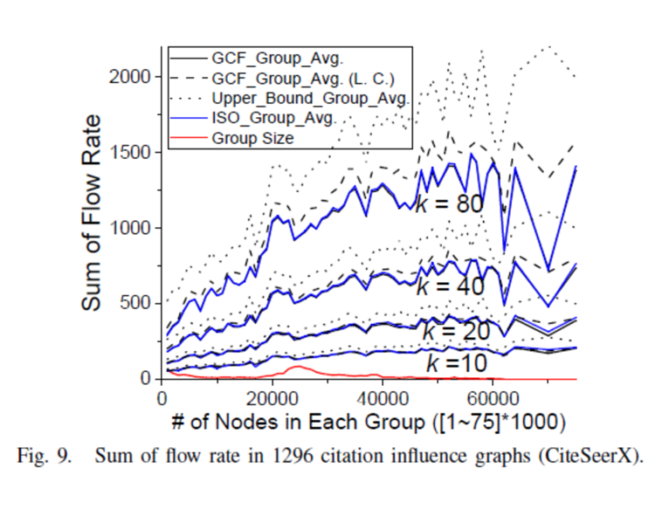
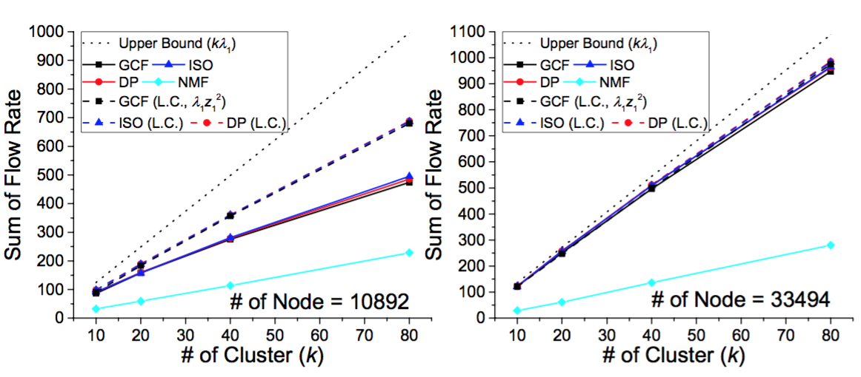
Evaluation – Static IGS Objective
IGS algorithms (GCF/ISO/DP) are much better than decomposition-based method in most cases
GCF/ISO perform close to DP
Largest components are close to or larger than the overall objective
50% lower-bound is guaranteed compared with the theoretically best objective

Slide 17
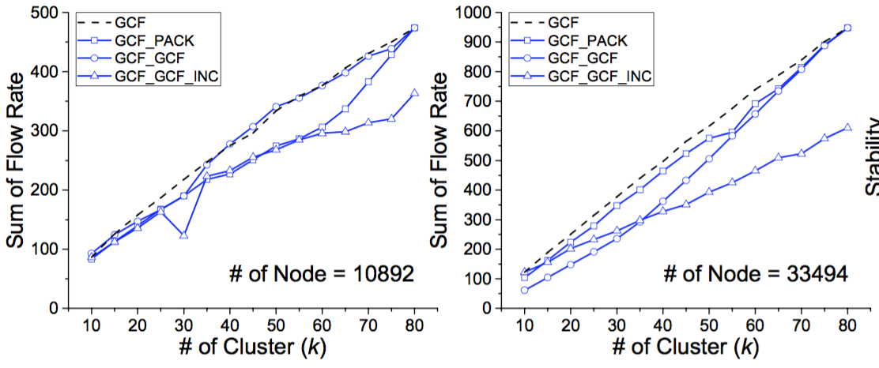
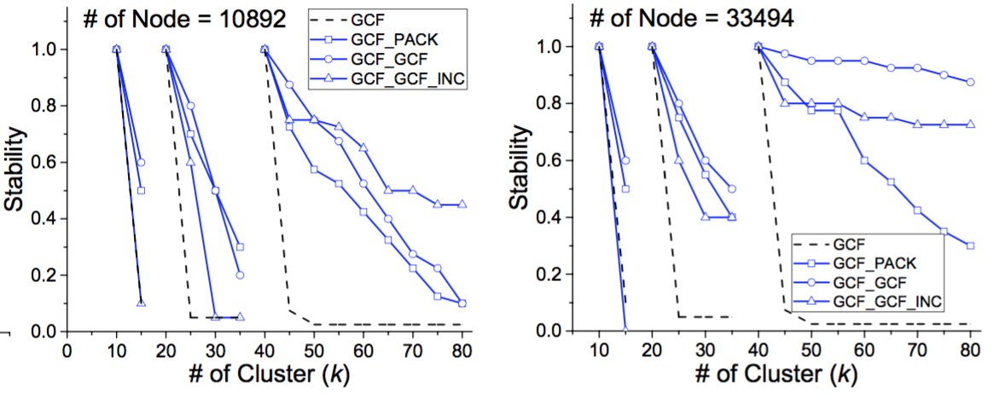
Evaluation – Dynamic IGS Objectives
Dynamic IGS algorithms achieve good trade-off: comparable IGS objective and much better stability of transition
Bottom-up dynamic IGS (GCF_GCF) is better than top-down dynamic IGS (GCF_GCF_INC)

Slide 18
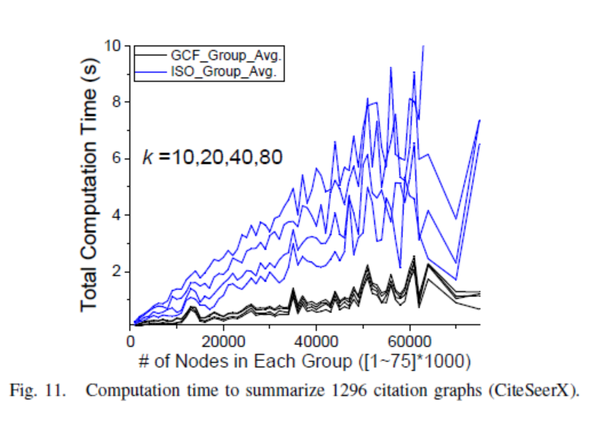
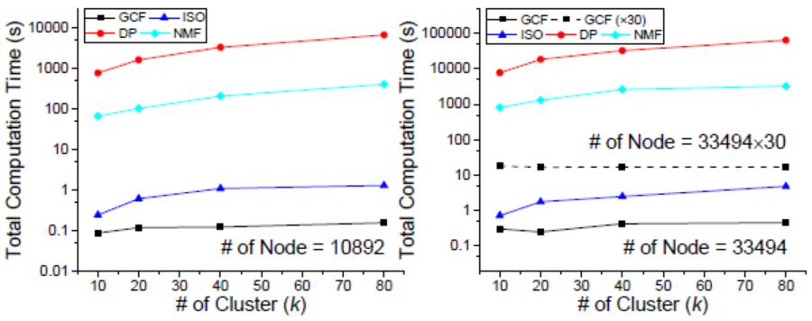
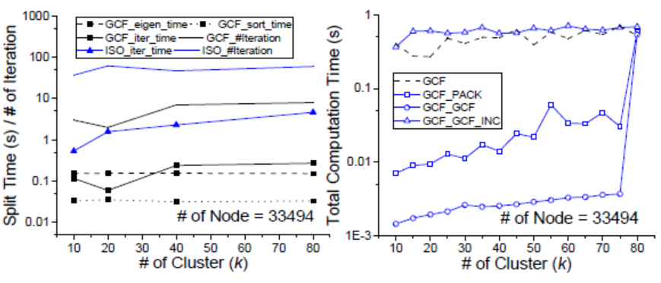
Evaluation – Algorithm Scalability
GCF>>ISO>>NMF>>DP
GCF algorithm suitable for large-scale influence graphs: 0.46 second to summarize 30000-node graphs, 16~18 seconds to summarize million-node graphs
GCF/ISO algorithm computation times grow slightly above linear
Dynamic GCF algorithm requires much less incremental computation time

Slide 19
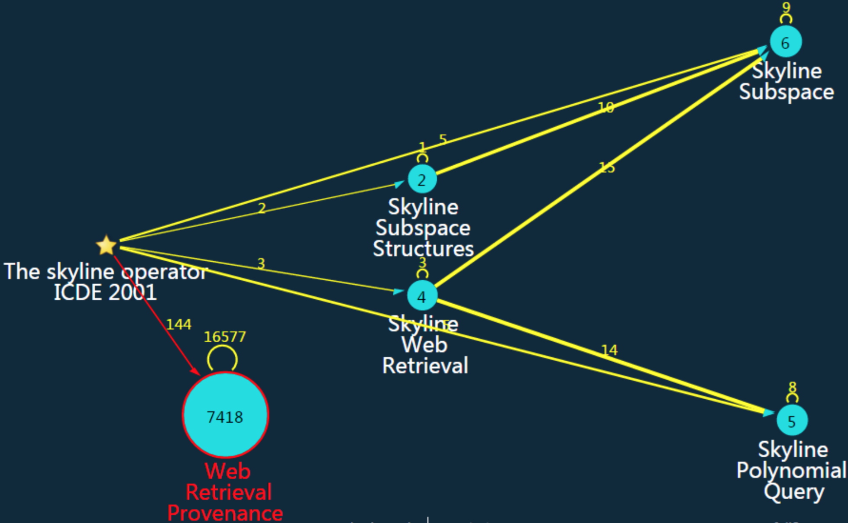
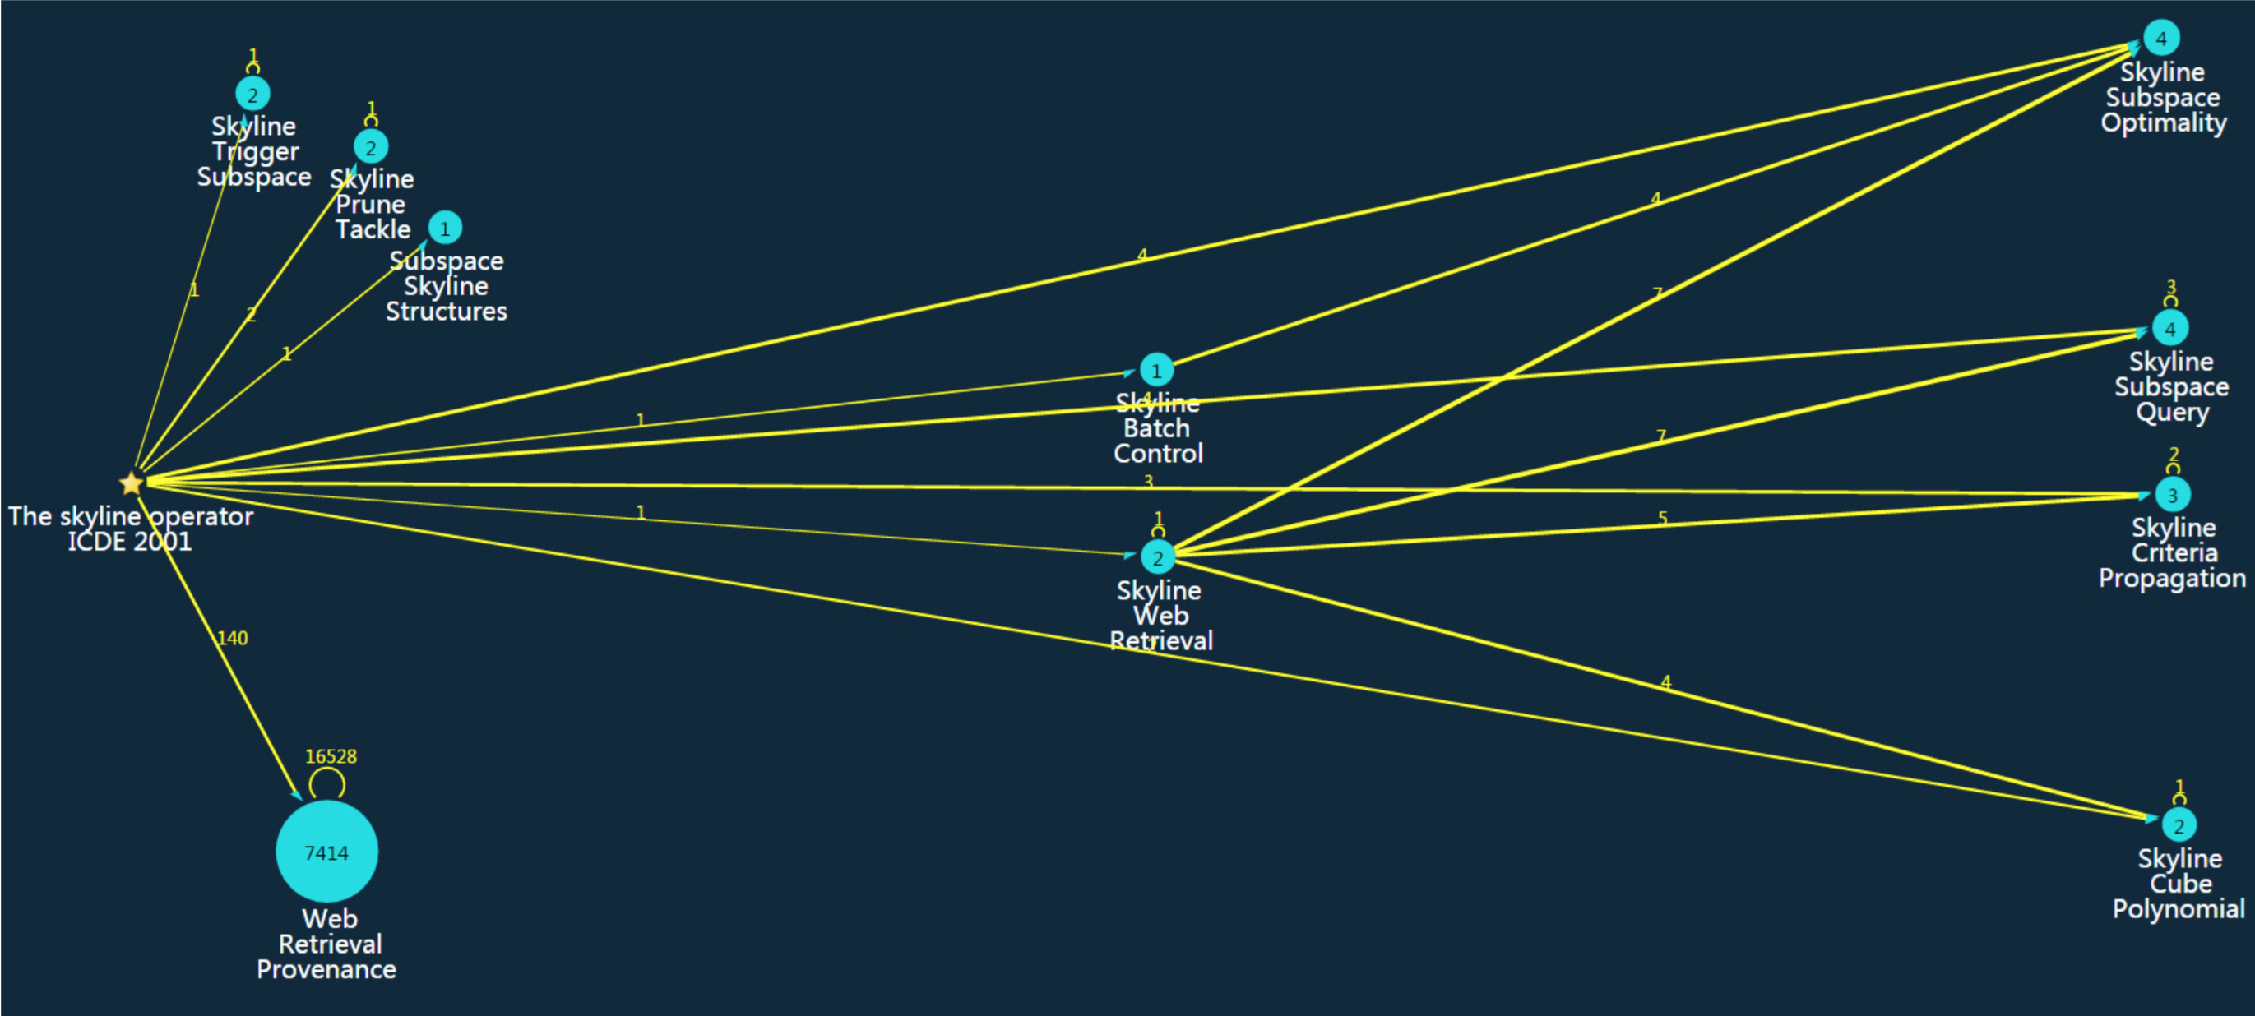
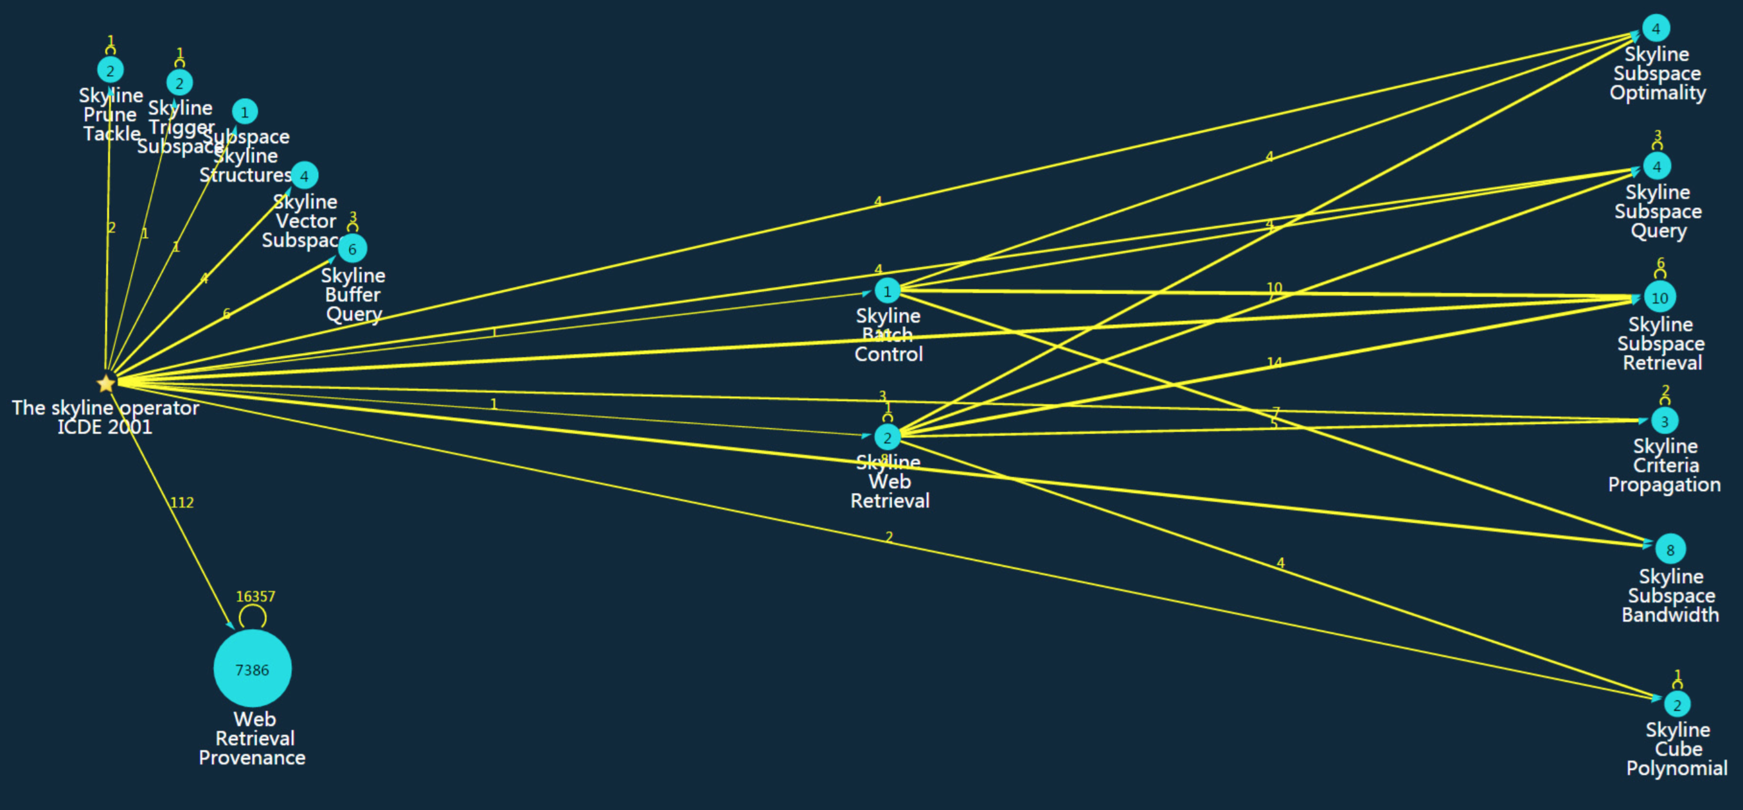
Case Study on CiteSeerX Dataset (GCF)
k=5
k=10
k=15

Slide 20
Case Study on CiteSeerX Dataset (NMF)
k=12
k=5
k=7

Slide 21
Conclusion
We propose a series of near perfect algorithms on the influence graph summarization problem:
Optimality
Theoretically solve the IGS problem
Design both exact and heuristic algorithms for IGS with performance guarantees
Scalability
The best algorithm has a complexity of O(n lgn)
Scale to summarize million-node influence graphs in about 10 seconds
Flexibility
Propose the dynamic IGS problem
Extend the static IGS algorithm to the dynamic setting

Slide 22
Questions?

